Slide 3
What is a ‘stronghold’?
Fortress or Citadel –
a fortified or defended place
God is called our “stronghold”.
Psalm 9:9
The LORD also will be a stronghold for the oppressed, a stronghold in times of trouble;

Slide 4
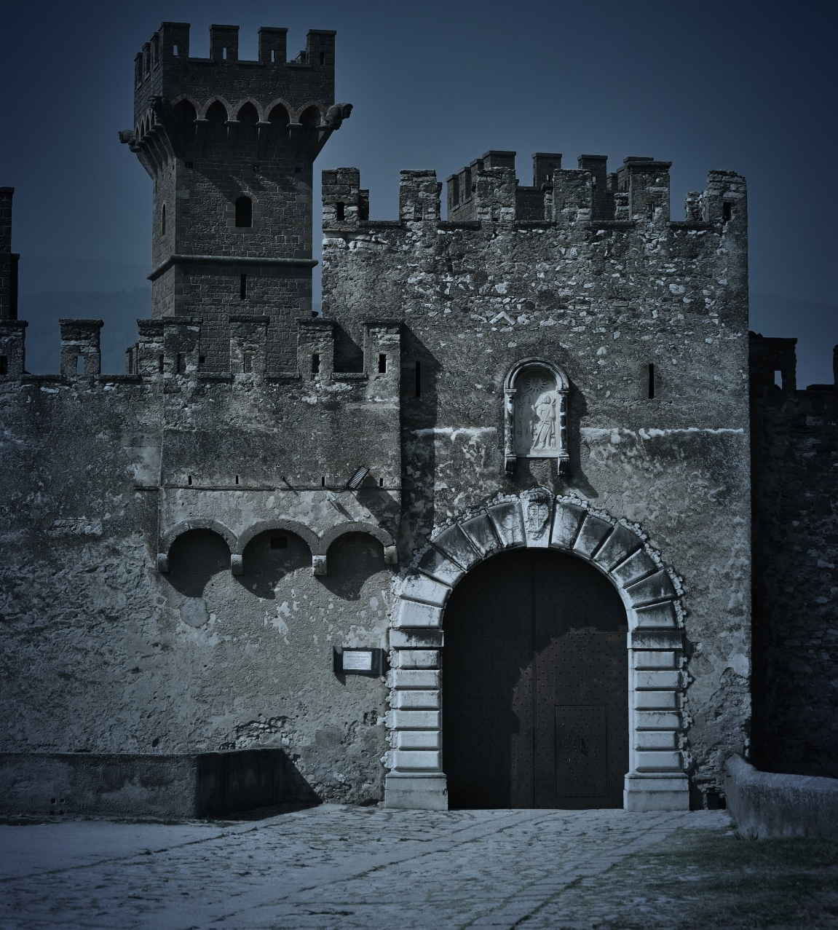
What are enemy ‘strongholds’?
An area of our life where evil spirit(s) have influence or control
An area of the mind, will, emotions, imagination, or flesh where we have lost control
Romans 6:15-16
Don’t you realize that whatever you choose to obey becomes your master?

Slide 5
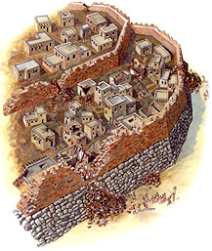
Ancient Jericho-Law of Possessing the Land
Numbers 33:50-53; 55
Drive out all the inhabitants … destroy all their figured stones, and destroy all their molten images and demolish all their high places … if you do not ... they will become as pricks in your eyes, thorns in your sides, … they will trouble you.

Slide 6
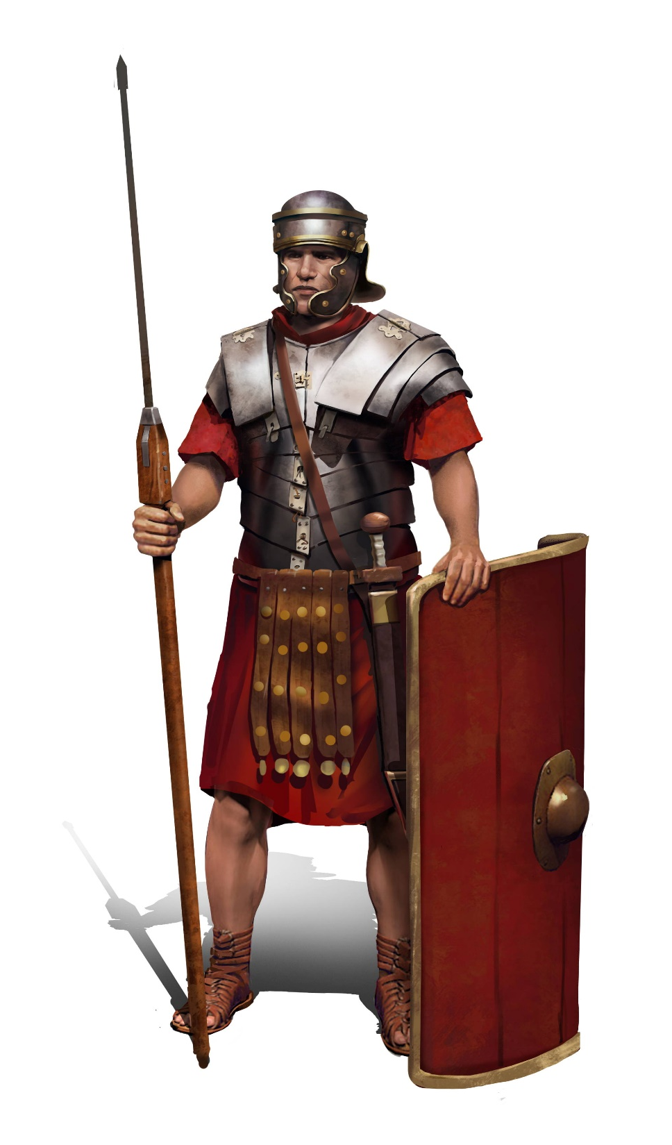
Put on the Full Armor of God
Spiritual Warfare
2 Corinthians 10:3-5
For though we walk in the flesh, we do not war according to the flesh. For the weapons of our warfare are not carnal but mighty in God for pulling down strongholds, casting down arguments and every high thing that exalts itself against the knowledge of God, bringing every thought into captivity to the obedience of Christ, …

Slide 7
How do I know if I have an enemy stronghold in my life?

Slide 8
We can be taken captive in areas of our life …
Innocently
Ignorantly
Willfully

Slide 9
Innocently – through Lineage Holds or Curses
Familiar spirits connected to the sin patterns of the family line.
Curses spoken by relatives or others in authority against a believer’s character, appearance, or abilities.

Slide 10
Innocently – when the source of sickness or affliction is demonic
Luke 13:10-13
The woman who has been disabled by a spirit for over 18 years was set free when Jesus called out to her, “Woman you are free of your disability”.

Slide 11
Innocently – when we engage in the occult and/or sinful activities not knowing the danger
Hebrews 5:2
He can deal gently with the ignorant and wayward, since he himself is beset with weakness.

Slide 12
Willfully – we allow a sinful life-style from the past to continue after salvation
Ephesians 4:22 (Amplified)
Strip yourselves of your former nature [put off and discard your old unrenewed self] which characterized your previous manner of life and becomes corrupt through lusts and desires that spring from delusion;

Slide 13
Willfully – if we turn back to past sinful attitudes and practices
Galatians 4:8-9
Formerly, when you did not know God, you were slaves to those who by nature are not gods. But now that you know God — or rather are known by God — how is it that you are turning back to those weak and miserable principles (spirits)? Do you wish to be enslaved by them all over again?

Slide 14
We open ourselves up to satanic influences through willful disobedience, rebellion, and indulgence.
Ephesians 4:25-5:1
Therefore, put away falsehood … be angry and do not sin, and give no opportunity to the devil. Let the thief no longer steal … Let no corrupt talk come out of your mouth … do not grieve the Holy Spirit … Let all bitterness, wrath, anger, clamor, and slander be put away from you … Be imitators of God.

Slide 15
Jesus wants to take us from bondage to freedom.
Are you saved but not free?
Colossians 1:21; 2:13
… you were formerly alienated and hostile in mind, engaged in evil deeds, … He made you alive with Him and forgave us all our trespasses.

Slide 16
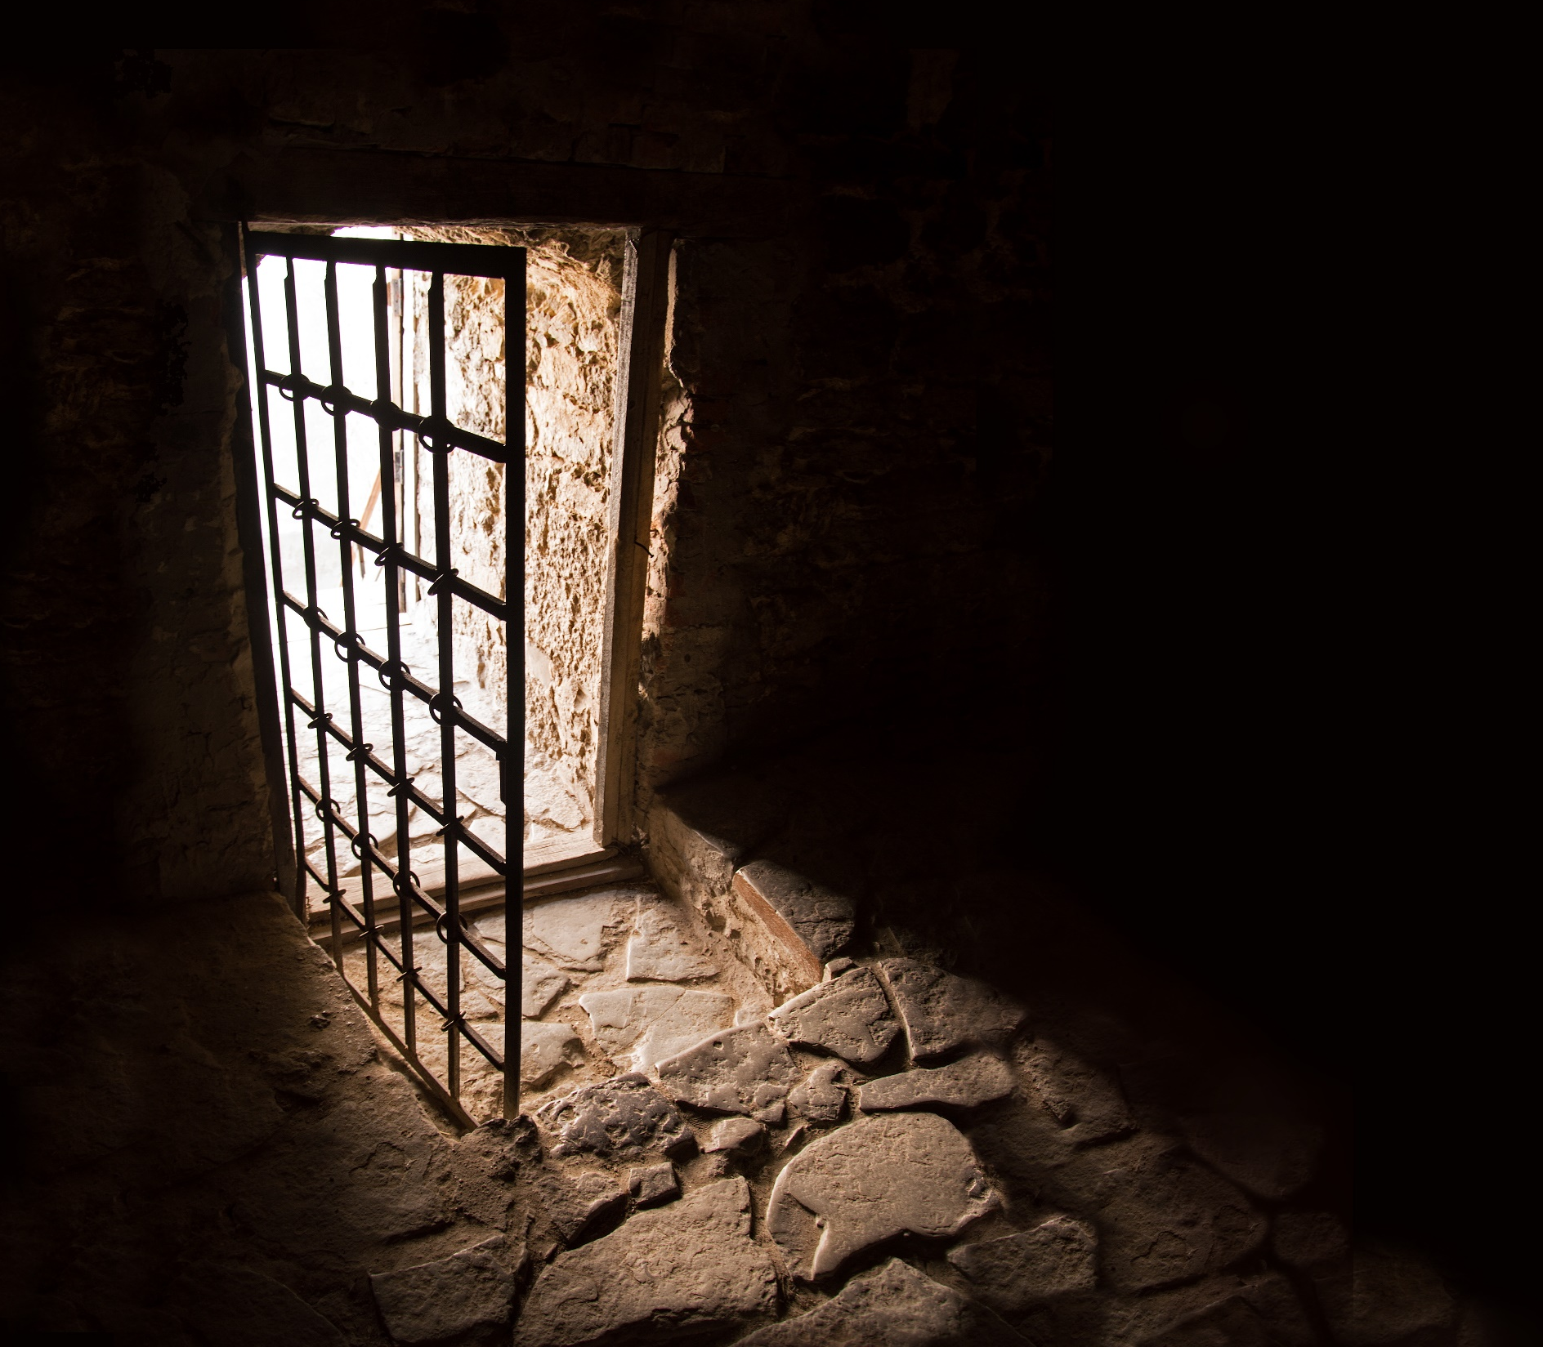
Spiritual Warfare
How are doors opened in my life to allow the enemy to take a ‘foothold’ in me?

Slide 17
Traumatic Experiences
When the experience of trauma weakens our ability to resist – a door may be opened to a stronghold of severe rejection, fear, shame, etc.

Slide 18
Lineage Holds and Curses
Exodus 20:5-6 (ESV)
You shall not bow down to them or serve them, for I the Lord your God am a jealous God, visiting the iniquity of the fathers on the children to the third and the fourth generation of those who hate me, but showing steadfast love to thousands of those who love me and keep my commandments.

Slide 19
Witchcraft / Rebellion
Any connection to the demonic kingdom.
1 Samuel 15:23
For rebellion is as the sin of divination, …

Slide 20
Witchcraft
Deuteronomy 18:10-14
There shall not be found among you anyone who burns his son or his daughter as an offering, anyone who practices divination or tells fortunes or interprets omens, or a sorcerer or a charmer or a medium or a necromancer or one who inquires of the dead, for whoever does these things is an abomination to the Lord. And because of these abominations the Lord your God is driving them out before you. You shall be blameless before the Lord your God, for these nations, which you are about to dispossess, listen to fortune-tellers and to diviners. But as for you, the Lord your God has not allowed you to do this.

Slide 21
Sin Bondage
Habitual areas of sin, addictive behaviors and idolatry – anything given priority over God.
You don’t control it, it controls you.

Slide 22
Biblical Description of Addiction
Ephesians 4:18-19 (NIV)
They are darkened in their understanding and separated from the life of God because of the ignorance that is in them due to the hardening of their hearts. Having lost all sensitivity, they have given themselves over to sensuality so as to indulge in every kind of impurity, with a continual lust for more.

Slide 23
Mental / Emotional Bondage Most common ground of enemy access
The mind through passivity, deception, delusion, high reasoning, evil imaginations, lies, fantasies, etc.
Excessive or suppressed emotions.
Areas of compulsive behaviors or obsessions.

Slide 24
Excessive or Extreme EMOTIONS
Ephesians 4:26-27
In your anger do not sin": Do not let the sun go down while you are still angry, and do not give the devil a foothold.
When the emotion controls you, you no longer control it — a stronghold may be present.

Slide 25
Sexual Impurities
All sexual activity not ordained by God.
There is an open highway of demonic connection when sexual union (oneness) occurs outside of marriage.

Slide 26
Sexual Impurities
1 Corinthians 6:15-20
Do you not know that your bodies are members of Christ himself? Shall I then take the members of Christ and unite them with a prostitute? Never! Do you not know that he who unites himself with a prostitute is one with her in body? For it is said, "The two will become one flesh.“ But he who unites himself with the Lord is one with him in spirit.

Slide 27
Sexual Impurities
Flee from sexual immorality. All other sins a man commits are outside his body, but he who sins sexually sins against his own body. Do you not know that your body is a temple of the Holy Spirit, who is in you, whom you have received from God? You are not your own; you were bought at a price. Therefore honor God with your body.

Slide 28
Bondage in Self-Image
Curses spoken by someone or even by oneself that have been accepted regardless of what God has said about us.
Abuse that brought in lies: ‘you are worthless’, etc.

Slide 29
Proverbs 18:21 (ESV)
Death and life are in the power of the tongue, and those who love it will eat its fruits.

Slide 30
Ephesians 4:22-24, 27
… to put off your old self, which is being corrupted by its deceitful desires; to be made new in the attitude of your minds; and to put on the new self, created to be like God in true righteousness and holiness. … and do not give the devil a foothold.

Slide 31
Unforgiveness
Refusal to give to others what you have been given by the Lord Jesus Christ.

Slide 32
Matthew 6:14-15
For if you forgive men when they sin against you, your heavenly Father will also forgive you. But if you do not forgive men their sins, your Father will not forgive your sins.

Slide 33
A Stronghold of Fear
Any fear that is repetitious, excessive and controlling is suspect.

Slide 34
Bondage of Fear
2 Timothy 1:7 (ESV)
… for God gave us a spirit not of fear but of power and love and self-control.

Slide 35
Physical Offenders
Any prolonged illness or symptom that does not respond to normal medical diagnosis or treatment is suspect. (to be examined for spiritual connections)

Slide 36
Unconfessed Sin
Any sin that we are aware of in our life that has not been brought to the Lord in confession – unwilling to repent.

Slide 37
Harassing Spirits Before or after deliverance …
Spirits assigned to continually harass and torment.
These spirits may try to rob us of our freedom and gain ground by attacking or tempting in old areas.

Slide 38
Spiritual Blocks and False Spiritual Gifts
Doors opened through false ministry, hands laid on in false ministry, false anointing, unbiblical spiritual practices, and spiritual witchcraft.

Slide 39
1 Timothy 5:22
Do not be hasty in the laying on of hands, and do not share in the sins of others. Keep yourself pure.

Slide 40
Spiritual Blocks
2 Corinthians 11:13-15
For such men are false apostles, deceitful workmen, masquerading as apostles of Christ. And no wonder, for Satan himself masquerades as an angel of light. It is not surprising, then, if his servants masquerade as servants of righteousness. Their end will be what their actions deserve.

Slide 41
Breaking Patterns of Bondage
Jesus came to ‘set the captives free’.
God wants free us and heal our broken relationships and restore us to our full purpose and place in the Body of Christ.
We can have an abundant life NOW — not a life without trials, but one with victory and internal joy and peace.
We are called to resist the enemy with combat faith.
John 10:10
The thief comes only to steal and kill and destroy; I came that they may have life, and have it abundantly.

Slide 42
Lighthouse Ministry International
Home Office
P.O. Box 120297 | St. Paul, MN 55112
For Ministry Appointments
(651) 483-0888
Email
info@LighthouseMinistryIntl.org
Web
LighthouseMinistryIntl.org

